Slide 1

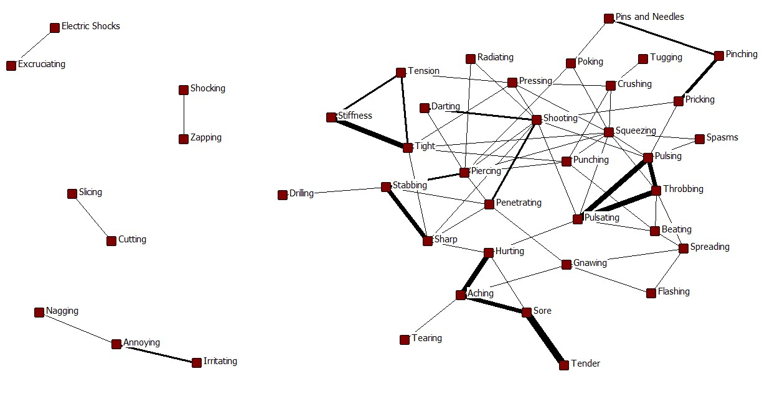
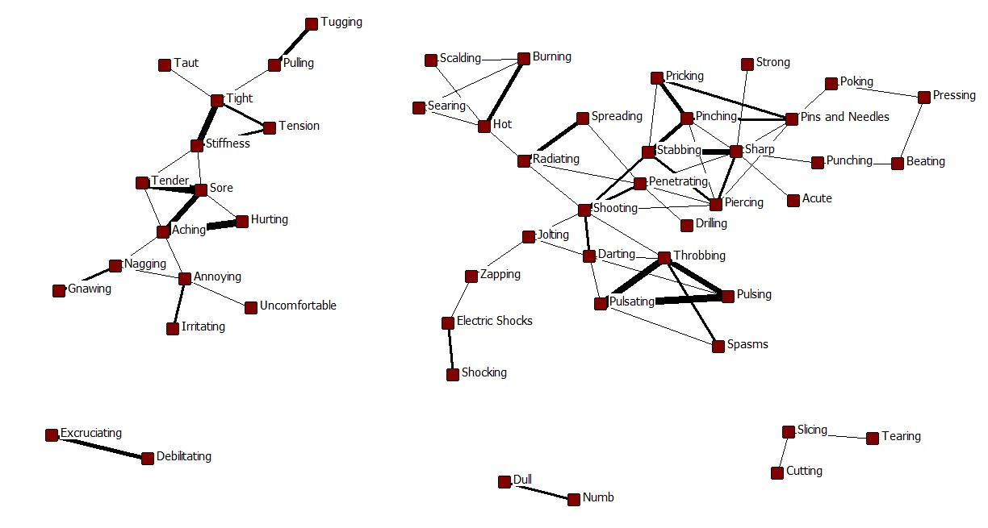
Mapping the Meanings of Words
Patients Use to Describe Their Pain
Scanlon M, Martin ML, McCarrier K, Wolfe M, Bushnell DM
Health Research Associates, Seattle, WA, USA
ISPOR
15th Annual European Congress
Berlin, Germany
November 6, 2012
Health Research Associates, Inc.
OBJECTIVE
Figure 1: Network map for Migraine subjects
To identify the meaning of descriptors patients use to describe the quality and severity of their pain, by mapping word clusters that patients identify as synonyms for the same pain sensation.
METHODS
Data Collection:
Subjects were recruited by web posting and telephone screening. Those self-reporting active treatment for Migraine or Low Back Pain (LBP) were scheduled for in-person interviews using card sort exercises with 93 different pain descriptors to identify those each subject commonly used to describe the pain associated with their condition, and to identify pairs of descriptors that describe the same pain.
Figure 2: Network map for LBP subjects
Analysis:
Synonym grids tallying patient identified equivalences were constructed for each condition (see Table 1).
Network maps that diagrammed patient identified equivalences between descriptors were created for each condition using Netdraw¹ (Figures 1-2). Ties (lines in the network map) represent equivalence between descriptors for 2 or more patients. Thicker ties mean more patients identified equivalence between descriptors. Network maps were compared across conditions.
Table 1: Example Synonym Grid
 | Piercing | Pinching | Pins and Needles | Pricking
Piercing | -- | 2 | 2 | 0
Pinching | 2 | -- | 3 | 4
Pins and Needles | 2 | 3 | -- | 3
Pricking | 0 | 4 | 3 | --
Migraine patients identified more descriptive synonyms to describe their pain (10% of all identified synonym pairs) than the LBP group (6%).
For the Migraine group, most words used synonymously formed a single large cluster of connections.
For the LBP group two main clusters of descriptors emerged, differentiating low-intensity pain (left) and high-intensity pain (right). The high-intensity cluster has clear sub-clusters differentiating incisive pain (STABBING-SHARP-PIERCING), thermal pain (HOT-BURNING), and THROBBING-PULSING-PULSATING pain.
Patients in both groups tended to identify ACHING-HURTING-SORE, RADIATING-SHOOTING, STIFFNESS-TIGHT-TENSION, and PULSATING-PULSING-THROBBING as synonymous.
LBP patients associated HURTING exclusively with ACHING and SORE, but Migraine patients linked it with SHARP and PULSATING as well.
LBP patients associated RADIATING with movement (SPREADING/PENETRATING) and thermal (HOT) descriptors, while Migraine patients tended to use it interchangeably with PIERCING.
Migraine patients described TIGHT as equivalent with SQUEEZING/PRESSING/PUNCHING, while LBP patients associated it with PULLING.
For LBP patients, SPREADING was closely associated with PENETRATING/RADIATING, while for Migraine patients it was linked to THROBBING/BEATING/GNAWING/FLASHING.
RESULTS
Table 2: Demographic characteristics
 |  | Migraine N=18 (100%) | LBP N=19 (100%) | Total N=37 (100%)
Age (Years): | Mean (SD) | 44.7 (11.6) | 36.7 (14.3) | 40.6 (14.0)
 | Median | 41.0 | 36.0 | 38.0
 | Range | 29-63 | 19-70 | 19-70
Gender: | Male | 2 (11%) | 8 (42%) | 10 (27%)
 | Female | 16 (89%) | 11 (58%) | 27 (73%)
Racial and Ethnic Group: | White/Caucasian (Non-Hispanic) | 11 (61%) | 11 (58%) | 22 (59%)
 | White/Caucasian (Hispanic) | 2 (11%) | -- | 2 (5%)
 | Black or African American | 3 (17%) | 4 (21%) | 7 (19%)
 | Hispanic or Latin(o/a) | 1 (6%) | 2 (11%) | 3 (8%)
 | Asian | 1 (6%) | 1 (5%) | 2 (5%)
 | Mixed Race | --- | 1 (5%) | 1 (3%)
Household Income: | Under $5,000 | --- | 1 (5%) | 1 (3%)
 | $5,000-$9,999 | --- | 1 (5%) | 1 (3%)
 | $10,000-$14,999 | --- | --- | 0 (0%)
 | $15,000-$24,999 | 2 (11%) | 3 (16%) | 5 (14%)
 | $25,000-$34,999 | 3 (17%) | 3 (16%) | 6 (16%)
 | $35,000-$49,999 | 3 (17%) | 2 (11%) | 5 (14%)
 | $50,000 and over | 10 (56%) | 9 (47%) | 19 (51%)
CONCLUSIONS
Some descriptors were used to convey a relatively consistent meaning across condition groups (e.g., PULSING-PULSATING-THROBBING, STIFFNESS-TIGHT-TENSION).
Other descriptors demonstrated condition-specific meaning (e.g., HURTING, RADIATING, SPREADING).
Overall, the network maps suggest greater differentiation of pain descriptors for the LBP group than the Migraine group.
These findings emphasize the importance of context of use when using pain as a study endpoint.
1. Borgatti SP 2002. Netdraw Network Visualization. Analytic Technologies: Harvard, MA.
.

